Slide 1
PHONE DIRECTORY APPLICATION
Dhruv Rastogi 2100290110051
Adarsh Kumar Dubey
Harsh Singh
2nd Year
3rd SEM
CSIT A2 Batch

Slide 2
INTRODUCTION
This C Phonebook small project enables you to do basic Phonebook
operations much as you would on your phone. Phonebook-related
records may be added, listed, modified, searched, and deleted. Almost
every function in this little project makes substantial use of file
management and data structure ideas.
Phonebook is a simple C mini project that will teach you the
fundamentals of functions, file handling, and data structure. This
program will show you how to add, list, change, edit, search, and
remove data from and into a file.
This mini project in C Phonebook allows you to perform simple
Phonebook operations like in your mobile. You can add, list, modify,
search and delete Phonebook-related records. File handling and data
structure concepts has been extensively used for almost all functions in
this mini project

Slide 3

AIM THE PROJECT
To develop an “Phonebook contact” application using cprogramming .
This program is very useful now-a-days to store completeinformation under single contact number.
This program also has options to deletion andmodification of the entered contact number.

Slide 4
ABOUT THE PROJECT
Phonebook is a very simple mini project in C that can help you understand
the basic concepts of functions, file handling and data structure. This
application will teach you how to add, list, modify or edit, search and delete
data to/from the file.
Adding new records, listing them, modifying them and updating, search
for contacts saved, and deleting the phonebook records are the basic
functions which make up the main menu of this Phonebook application.
Personal information such as name, sex, father’s name, phone number,
citizenship number, email and address are asked while adding a record
into the Phonebook. These records can then be modified, listed, searched
for and removed.
It is a very simple tool that helps you learn the basics of creating files,
file extensions, and how data is organized. This software shows you how
to add, view, edit, change, receive, and delete data from files.

Slide 5
I have used many functions in this mini project. These functions are easy
to understand as their name only signifies their respective operations.
• void menu() – This function is used to display the main menu.
• void start() – This functions calls the menu function mentioned
above.
• void back() – This function is used to go back to start.
• void addrecord() – It adds a new Phonebook record.
• void listrecord() – This function is used to view list of added records
in file.
• void modifyrecord() – This function is used to modify added records.
• void deleterecord() – It deletes record from file.
• void searchrecord() – It searches for added record by name.
It is a very simple tool that helps you learn the basics of creating files,
file extensions, and how data is organized. This software shows you how
to add, view, edit, change, receive, and delete data from files.
One of the main things you can do with the main phonebook application
(shown in the main menu below) is add new items, view them by logging
in, edit and update them, search for saved contacts, and delete data.

Slide 6
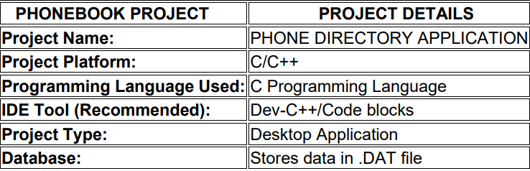
TECHNOLOGY USED

Slide 7
TOPICS RELATED TO DSUC ON WHICH PHONE DIRECTORY APPLICATION PROJECT IS MAPPED
1-D ARRAY
STRUCTURES
DATA TYPES (CHAR, INT, LONG INT)
STRINGS
FILE HANDLING

Slide 8
PROBLEM STATEMENT
Nowadays it is very difficult to hard core every details related to any phone number such as email address, father name, mother name, gender, citizen number etc on a paper and it is nearly impossible to modify previous details of a particular phone number and it also very difficult to search a particular number with details on a hard copy. We also cannot be able to delete any phone number with details

Slide 9
PROPOSED SOLUTION
This software is very useful nowadays to store full information under a single contact number. The software also has options for removing and changing the contact number entered. This C Phonebook small project enables you to do basic Phonebook operations much as you would on your phone. Phonebook-related records may be added, listed, modified, searched, and deleted. Adding new records, listing them, modifying them and updating, search for contacts saved, and deleting the phonebook records are the basic functions which make up the main menu of this Phonebook application

Slide 10
How To Run the Project?
In order to run the project, you must have installed Dev C++ or Code Blocks on your PC.

Slide 11

SOURCE CODE

Slide 12
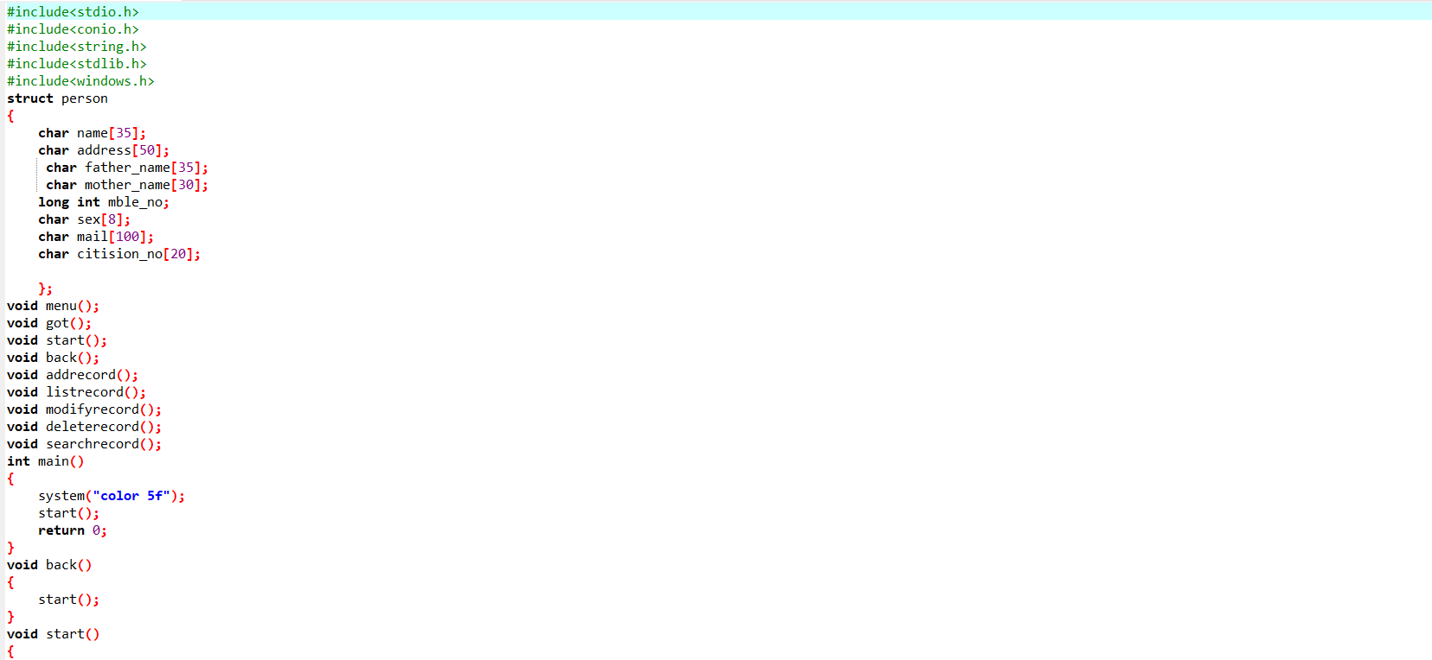

Slide 13
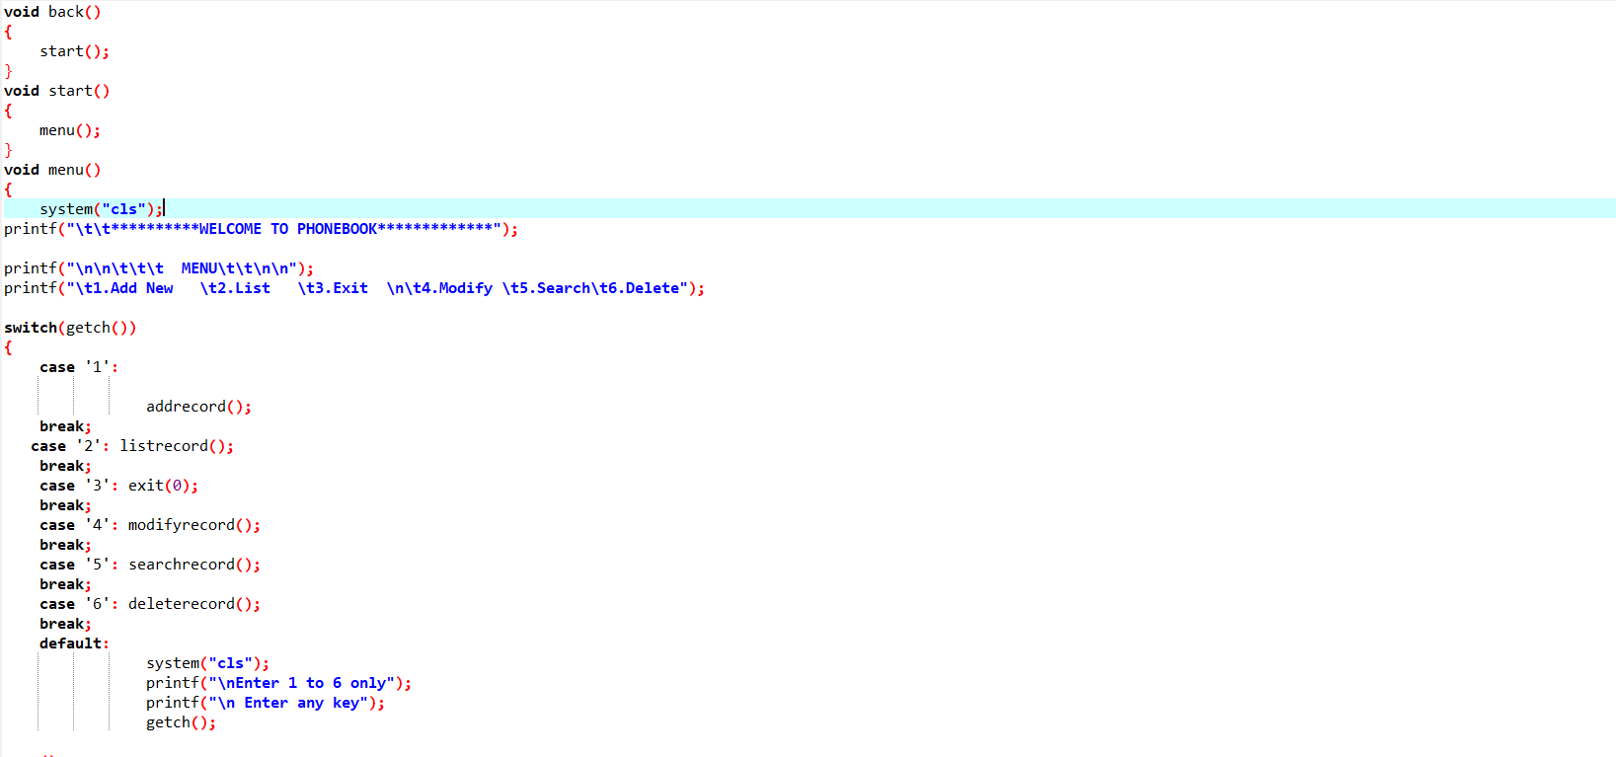

Slide 14
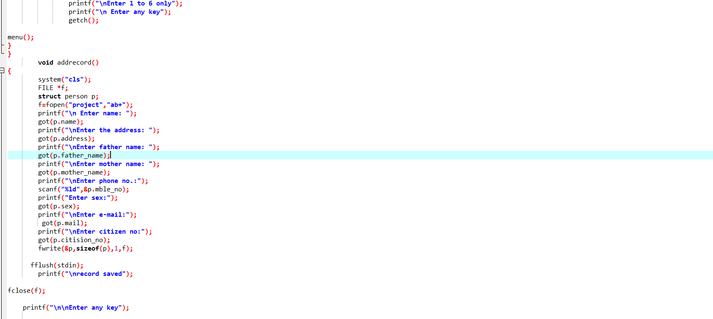

Slide 15
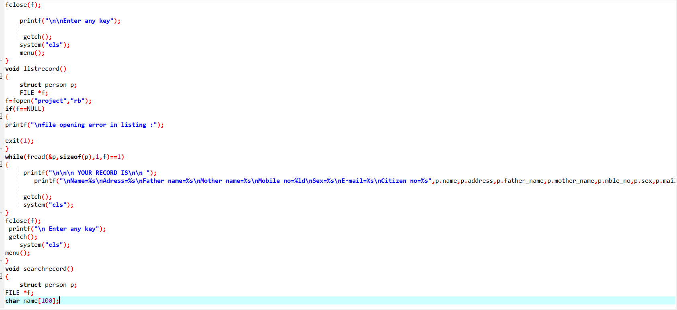

Slide 16
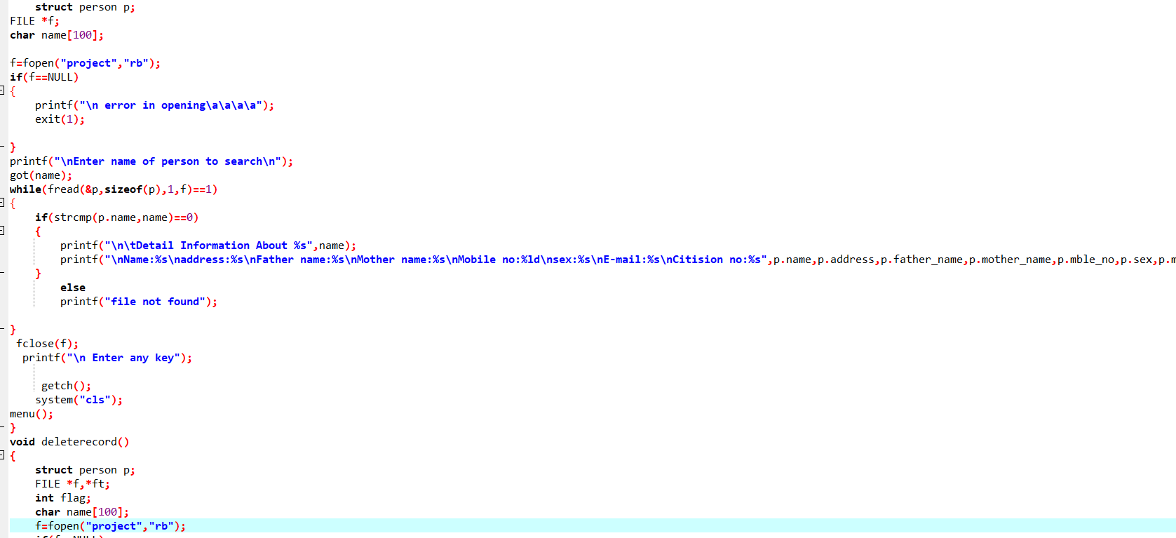

Slide 17
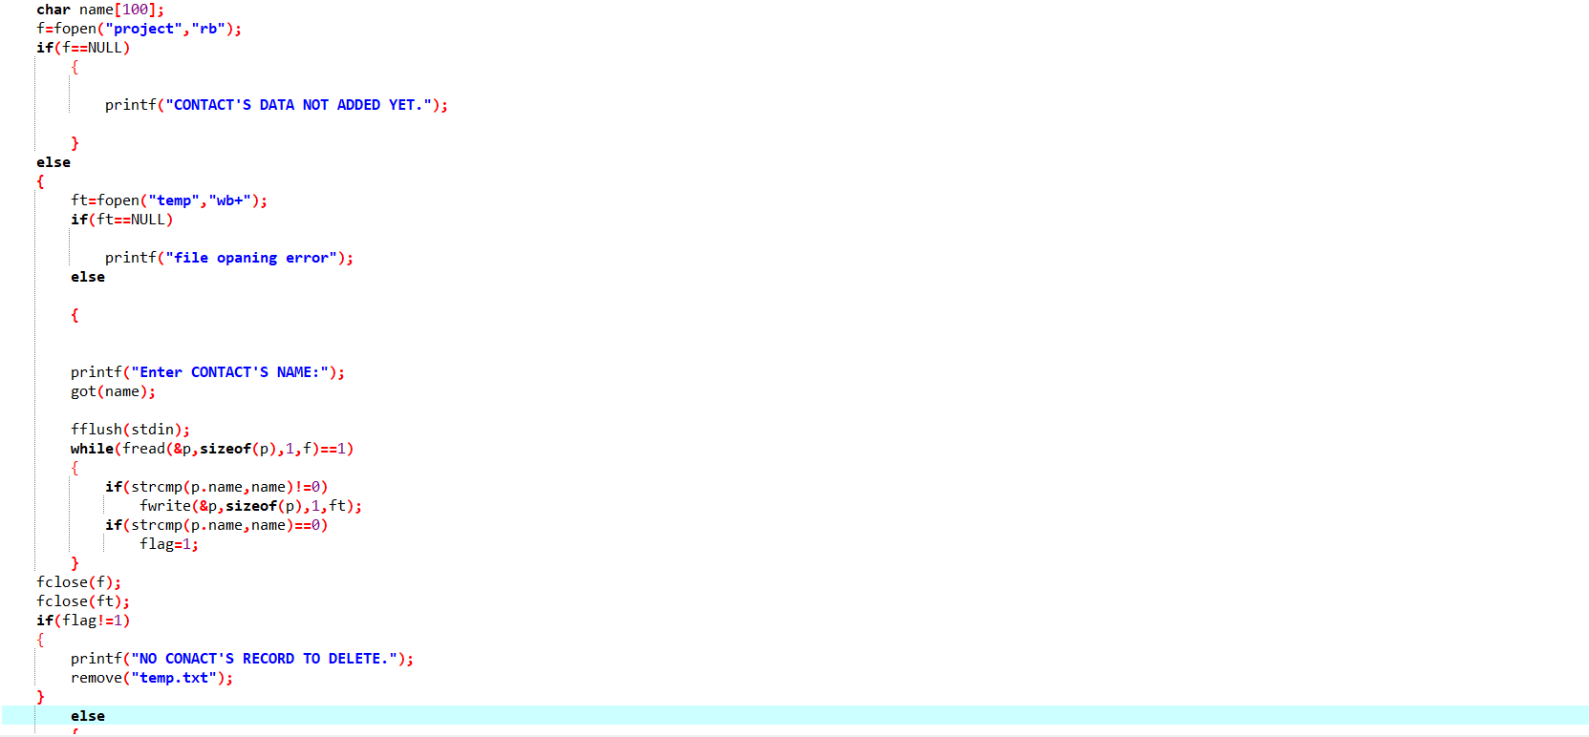

Slide 18
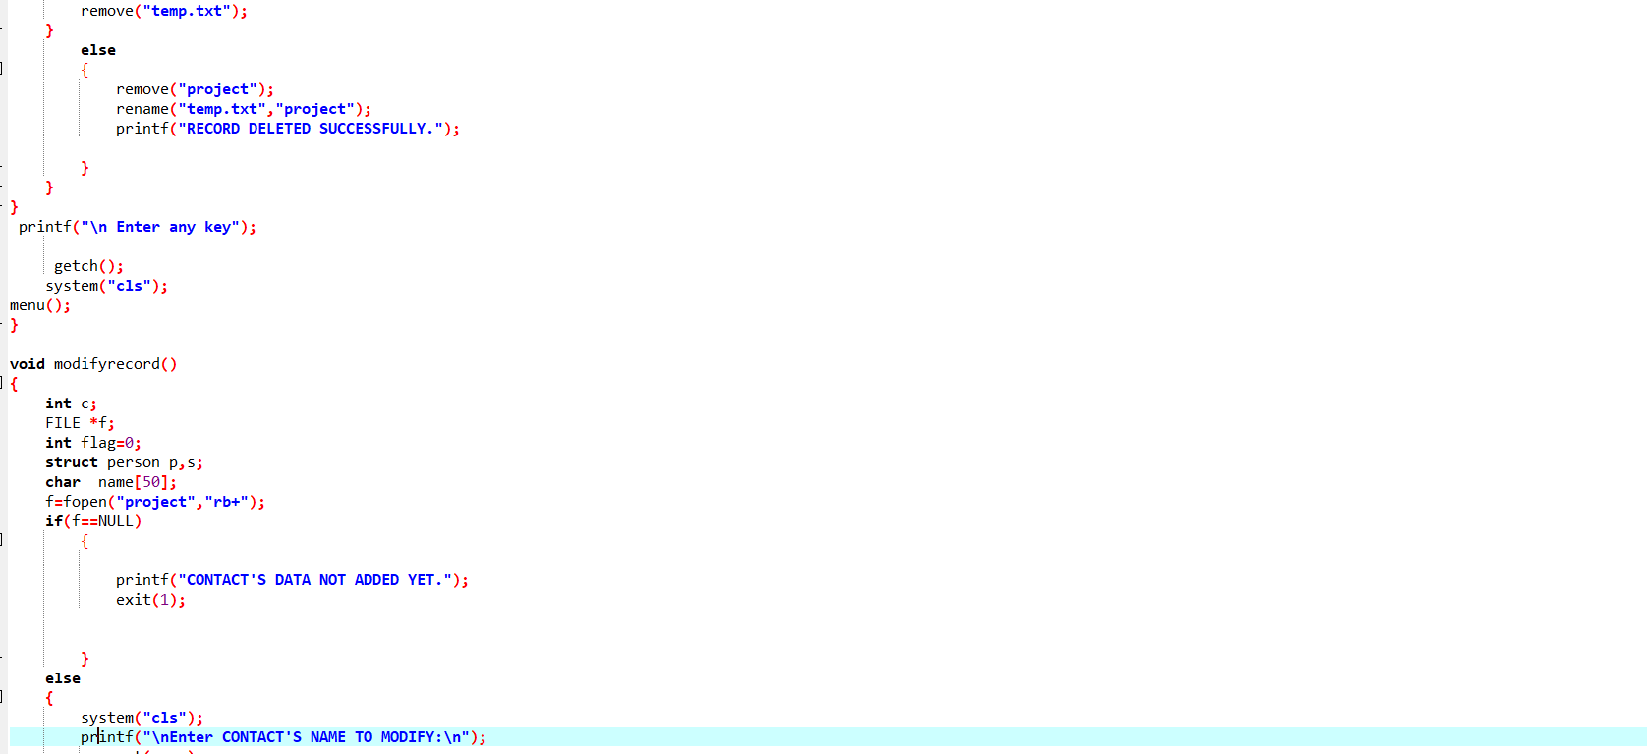

Slide 19
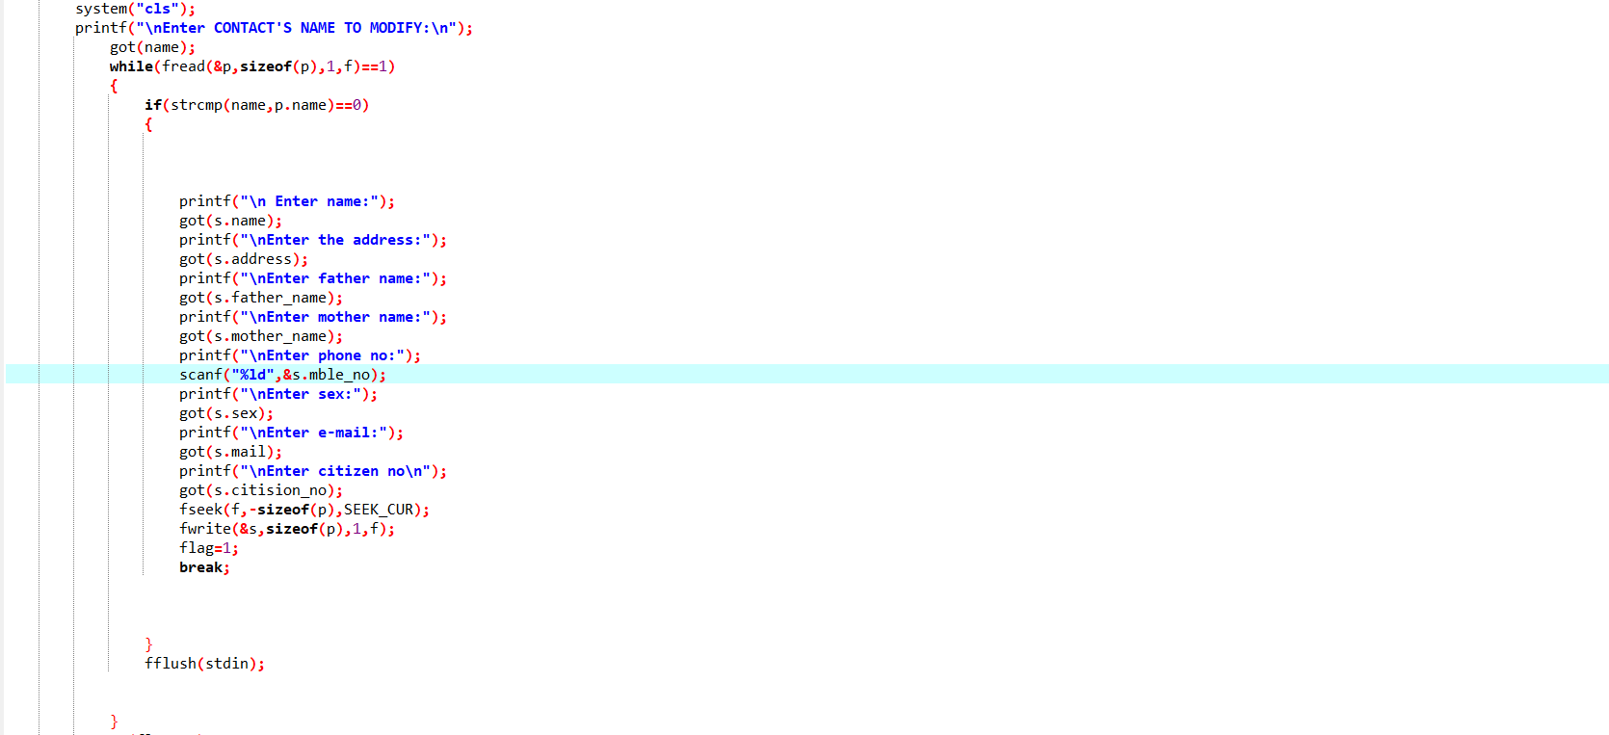

Slide 20
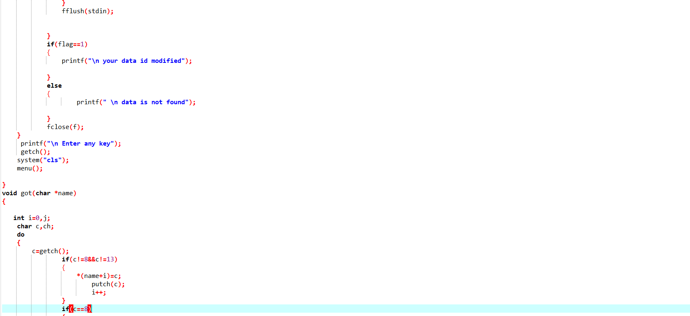

Slide 21
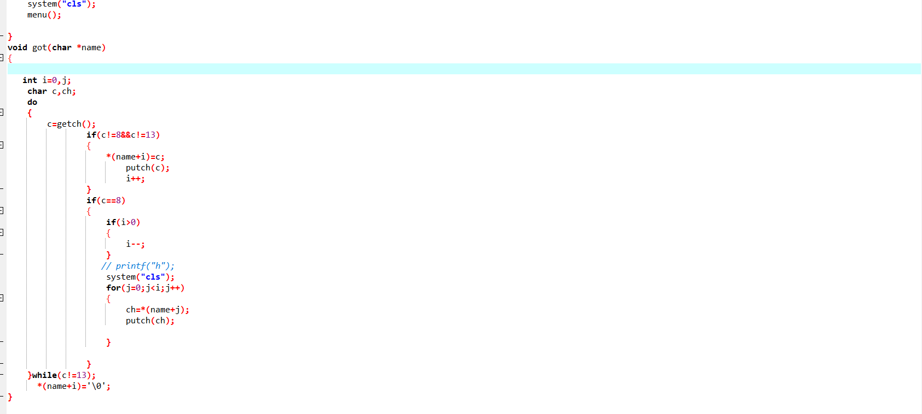

Slide 22
DEMO OF PROJECT

Slide 23
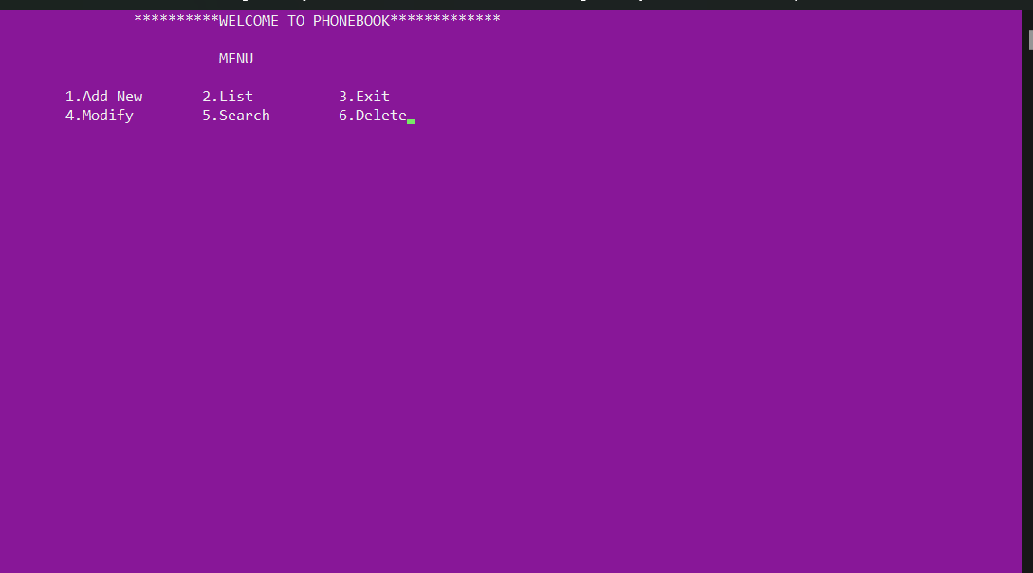

Slide 24


Slide 25
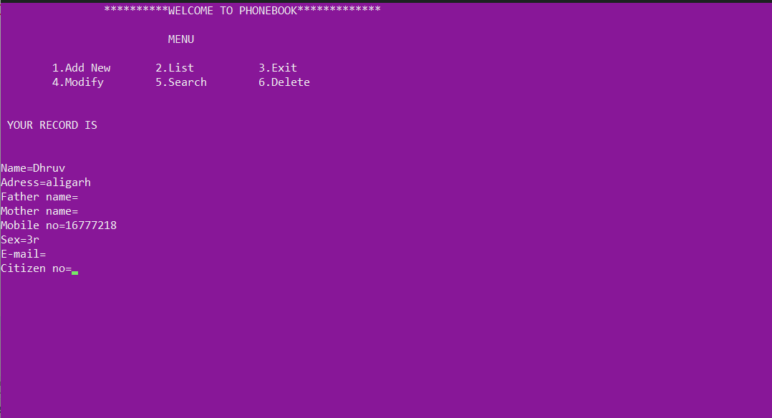


Slide 26
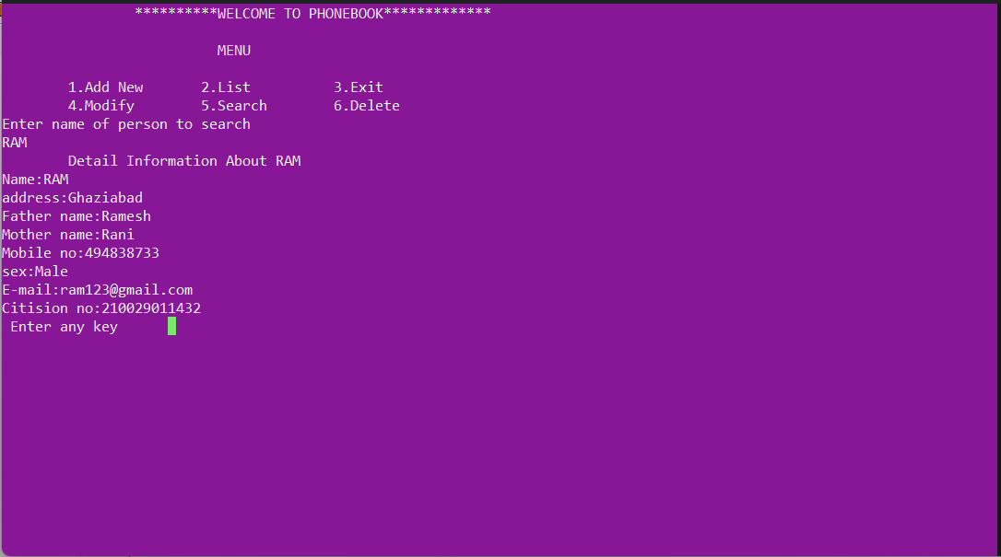

Slide 27
OUTCOME OF PROJECT
The phonebook is a very simple C mini project that can help you
understand the basic concepts of functions, file handling, and data
structure. This program will teach you how to add, list, change or edit,
search and remove data from/to a file. Adding new records, listing them,
editing and updating them, looking for saved contacts, and removing
phonebook records are simple Functions that make up the main menu of
this Phonebook program.
Personal information, such as name, gender, phone number, e-mail, and
address, is requested when you add a record to your phonebook. These
records can then be updated, entered, searched, and deleted. I’ve used
a lot of functions in this mini project. These functions are easy to
understand since their name means just their respective operations.

Slide 28
Advantages of the Project
It becomes easy for the user to store complete information( i.e e-mail id, address) about his contact.
It is easy for the user to just search his required contact number by just typing name of the contact.
Some times it becomes difficult to store more contacts(i.e over 150)
It becomes even difficult to store contacts with two or more contact numbers.
Limitations of the Project

Slide 29
FAQ’S
1. What is phonebook application?
Ans. The Phonebook app includes a basic set of functions for adding,
searching for, updating, and deleting new contacts. This mini-C
phonebook design enables you to perform basic tasks in your phonebook,
such as dialling numbers. You can add text to the phonebook, as well as
find, edit, search, and delete entries.
2. Why phonebook is important?
Ans. Because its goal is to find the phone number of a subscriber who has been
identified by name and address.
3. Does the phonebook still exist?
Ans. Yes, White pages and phone books are as old as the rotary-dial phone.
But both are still online in digital form.

Slide 30

THANK YOU
GITHUB LINK: https://github.com/Dhruv34w/Phone-Directory-Application

